Slide 1
Project Management & BIM Project Time Management
Project Time Management
Paul Vesey
Technological University of the Shannon
paul.vesey@tus.ie
Yangtze University Nov/Dec 2022

Slide 2
Project Management & BIM Project Scheduling Basics
Basic Project Scheduling
Gantt Charts

Slide 3
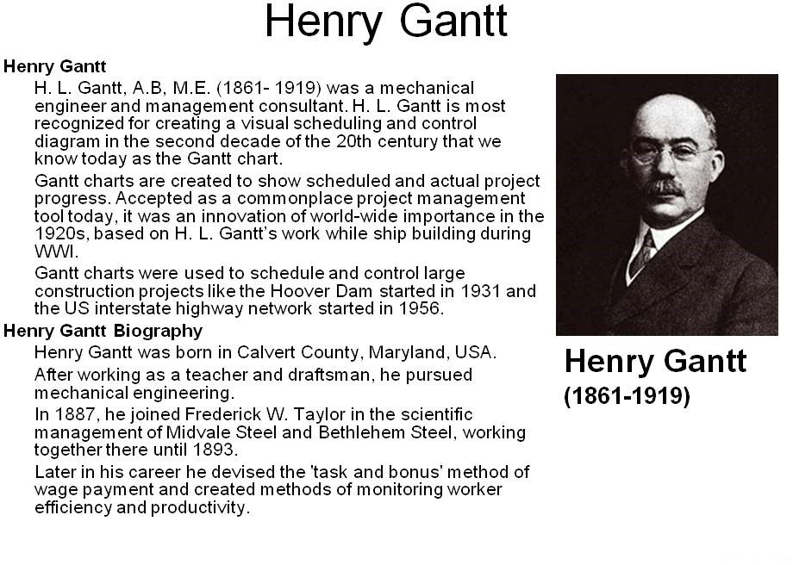
Project Management & BIM Project Scheduling Basics

Slide 4
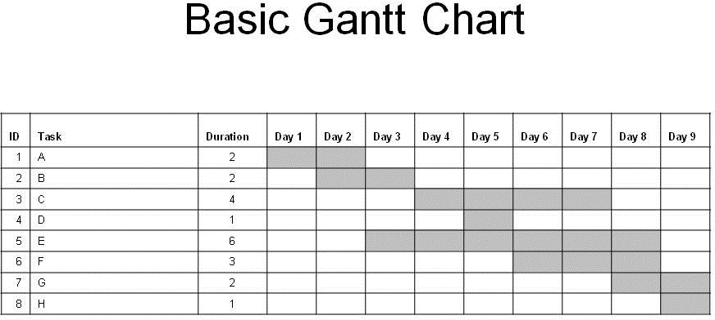
Project Management & BIM Project Scheduling Basics

Slide 5
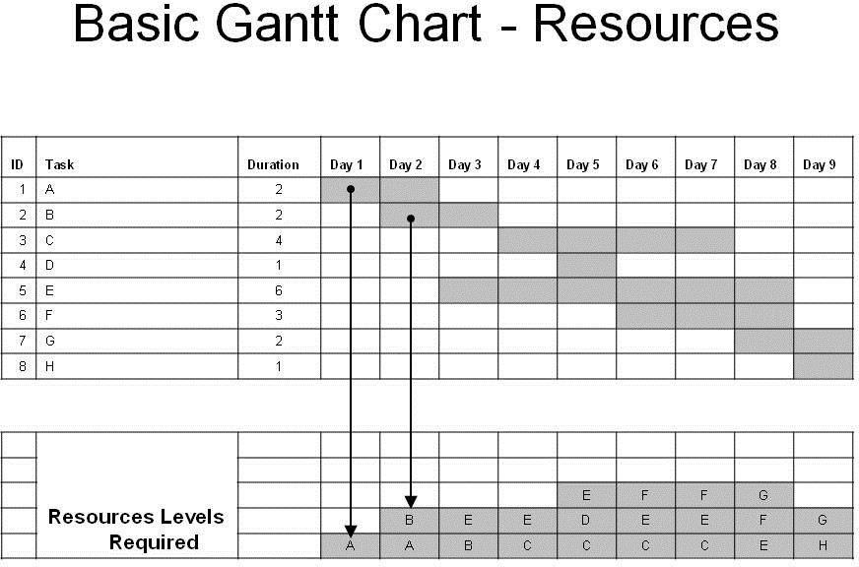
Project Management & BIM Project Scheduling Basics

Slide 6
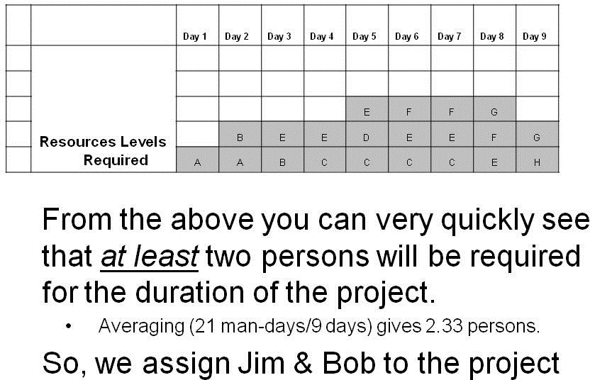
Project Management & BIM Project Scheduling Basics

Slide 7
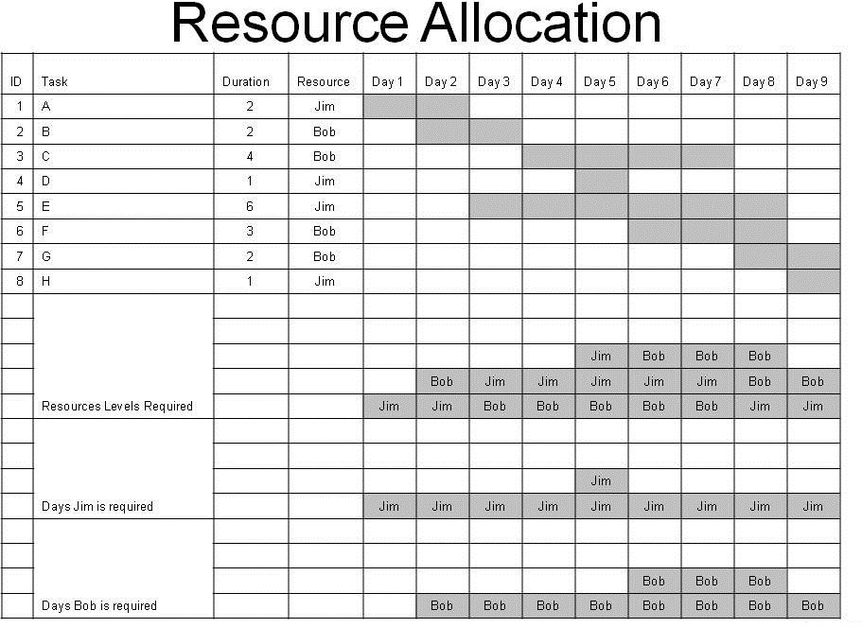
Project Management & BIM Project Scheduling Basics

Slide 8
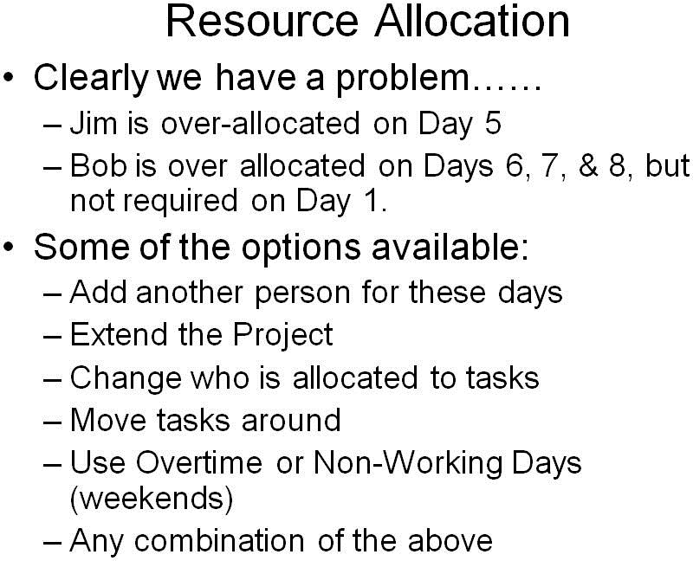
Project Management & BIM Project Scheduling Basics

Slide 9
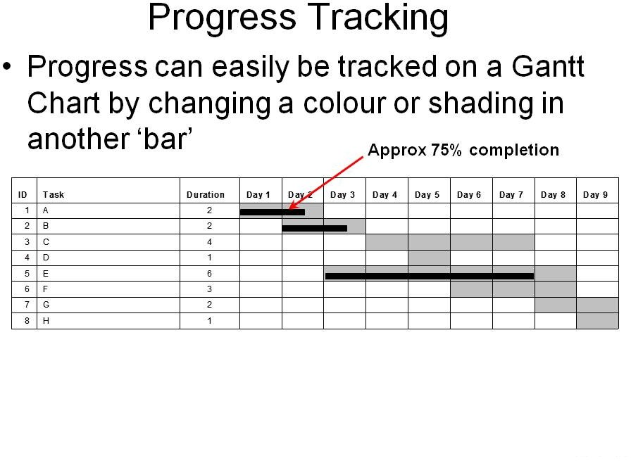
Project Management & BIM Project Scheduling Basics

Slide 10
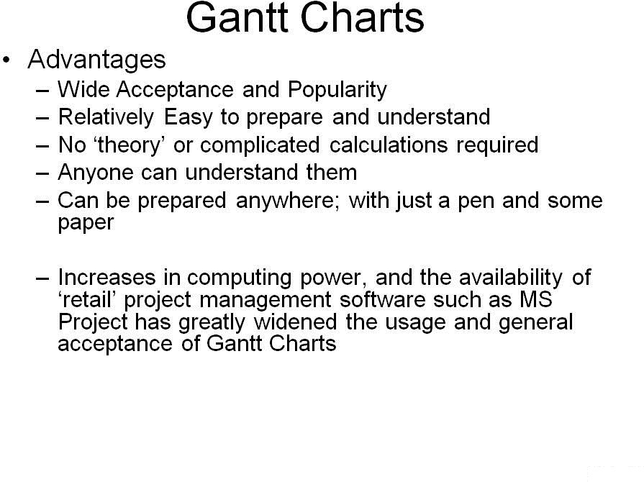
Project Management & BIM Project Scheduling Basics

Slide 11
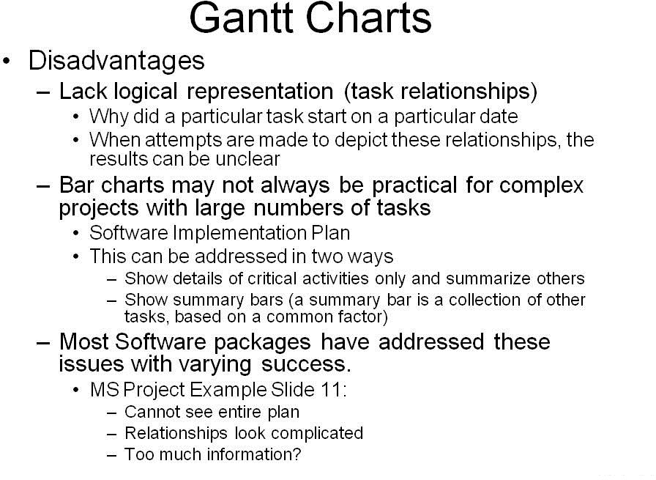
Project Management & BIM Project Scheduling Basics

Slide 12
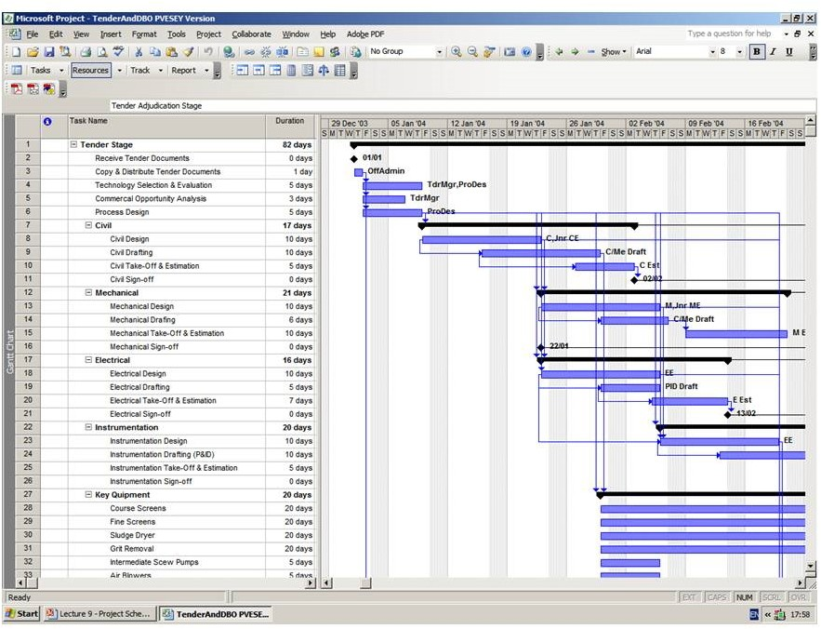
Project Management & BIM Project Scheduling Basics

Slide 13
Project Management & BIM Project Scheduling Basics
Basic Project Scheduling
Network Analysis

Slide 14
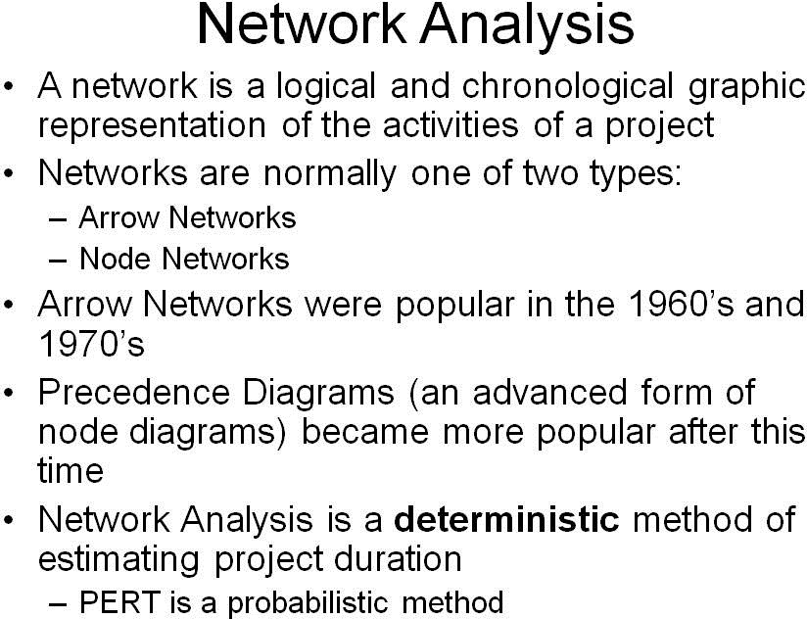
Project Management & BIM Project Scheduling Basics

Slide 15
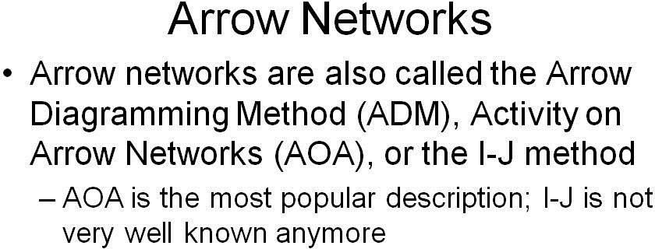
Project Management & BIM Project Scheduling Basics

Slide 16
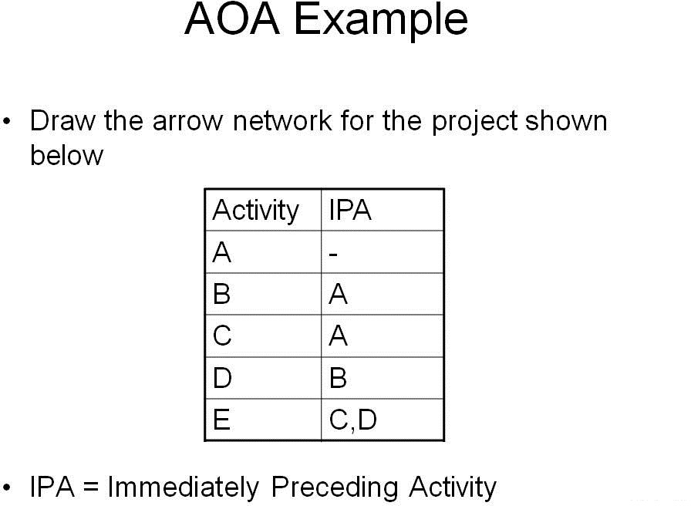
Project Management & BIM Project Scheduling Basics

Slide 17
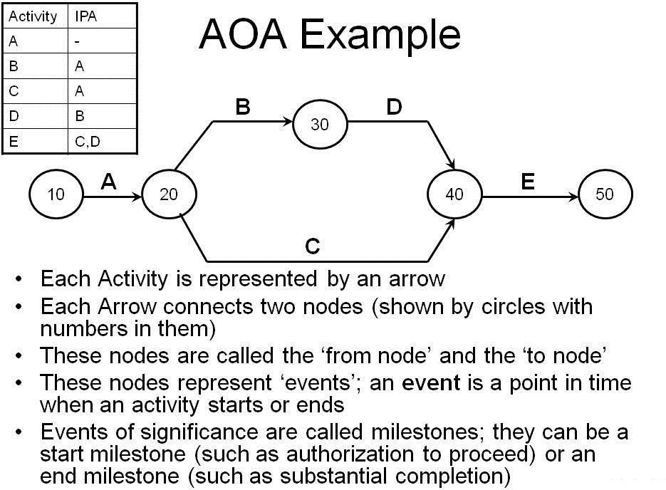
Project Management & BIM Project Scheduling Basics

Slide 18
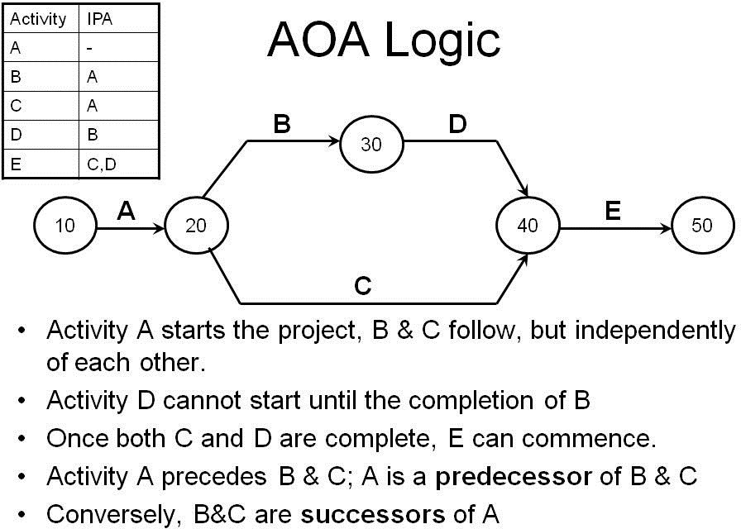
Project Management & BIM Project Scheduling Basics

Slide 19
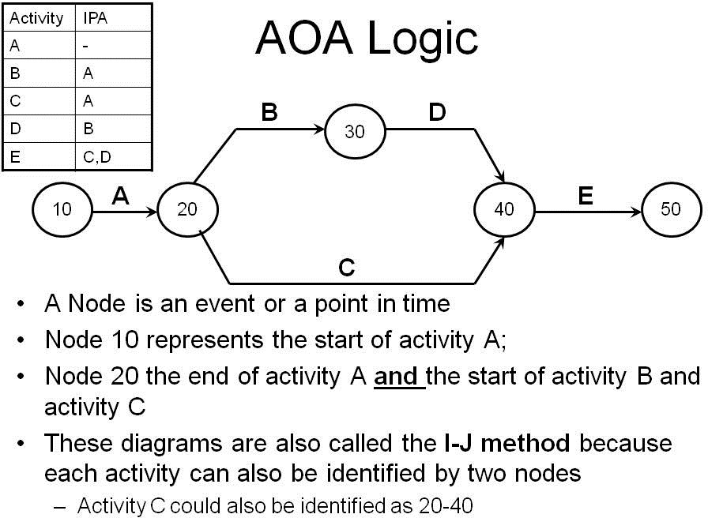
Project Management & BIM Project Scheduling Basics

Slide 20
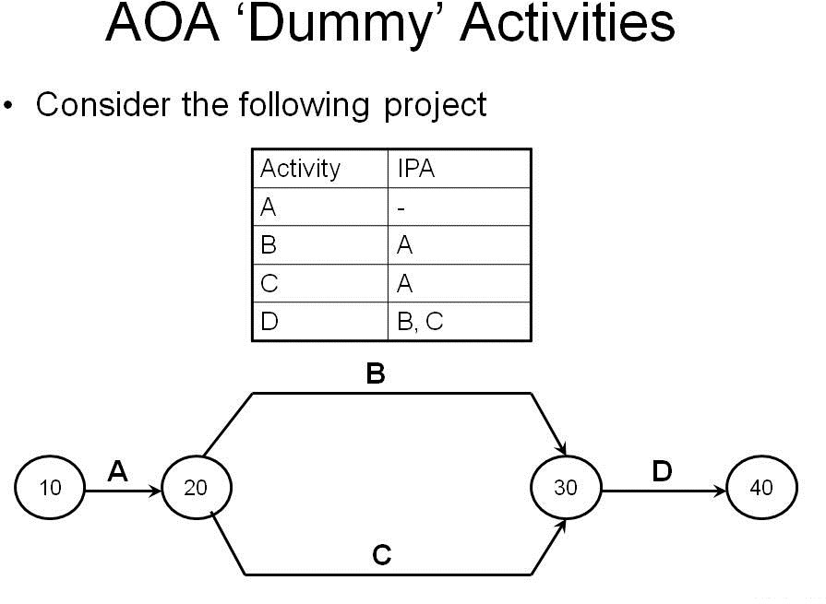
Project Management & BIM Project Scheduling Basics

Slide 21
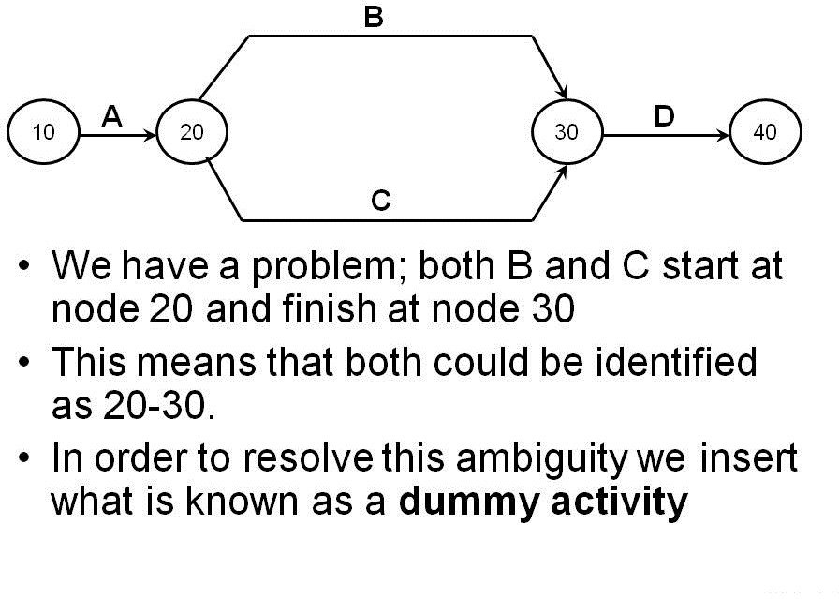
Project Management & BIM Project Scheduling Basics

Slide 22
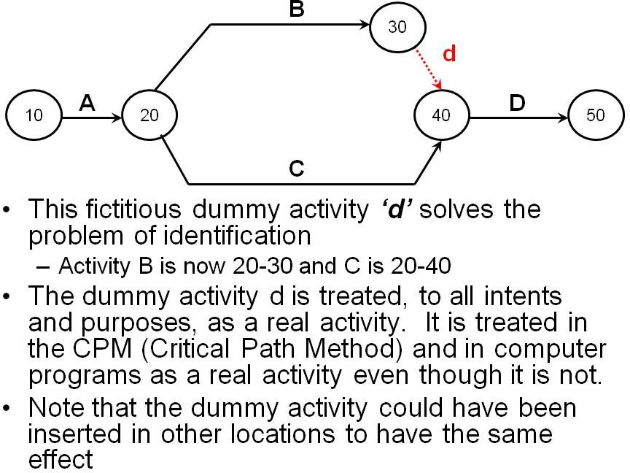
Project Management & BIM Project Scheduling Basics

Slide 23
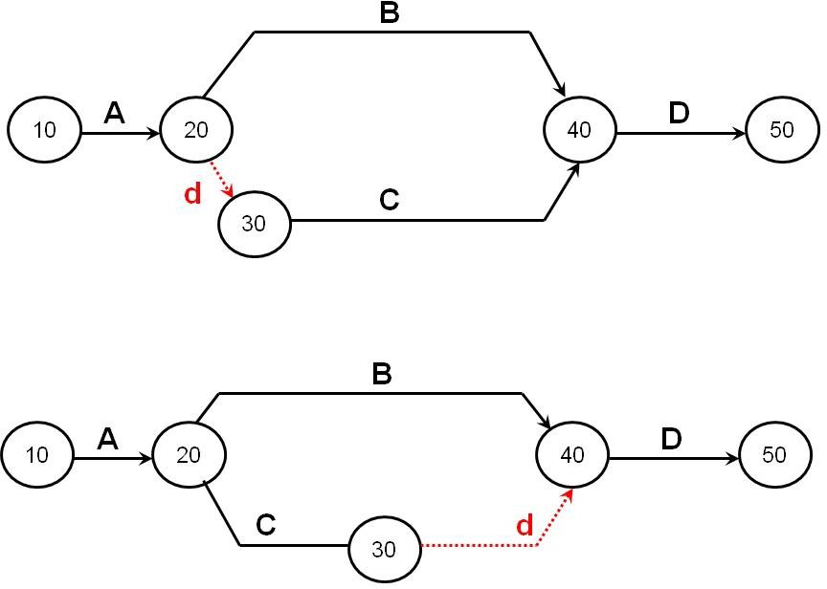
Project Management & BIM Project Scheduling Basics

Slide 24
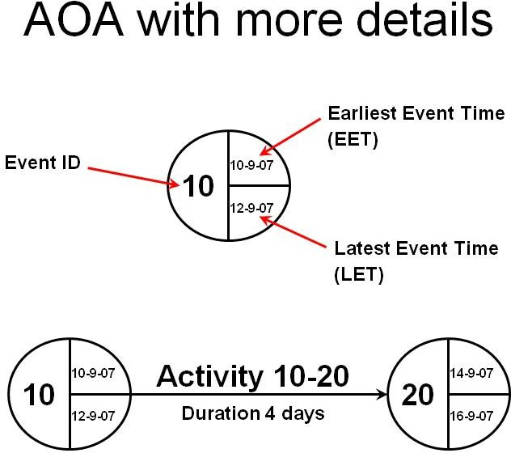
Project Management & BIM Project Scheduling Basics

Slide 25
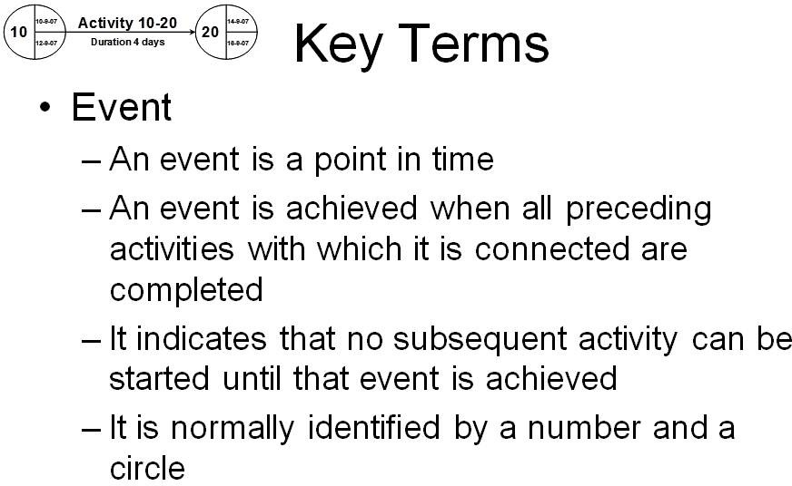
Project Management & BIM Project Scheduling Basics

Slide 26
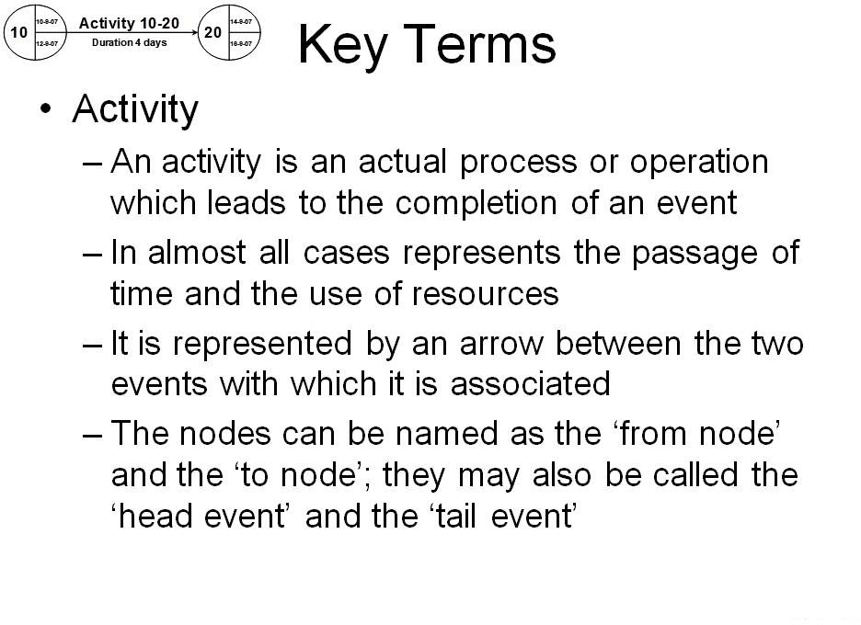
Project Management & BIM Project Scheduling Basics

Slide 27
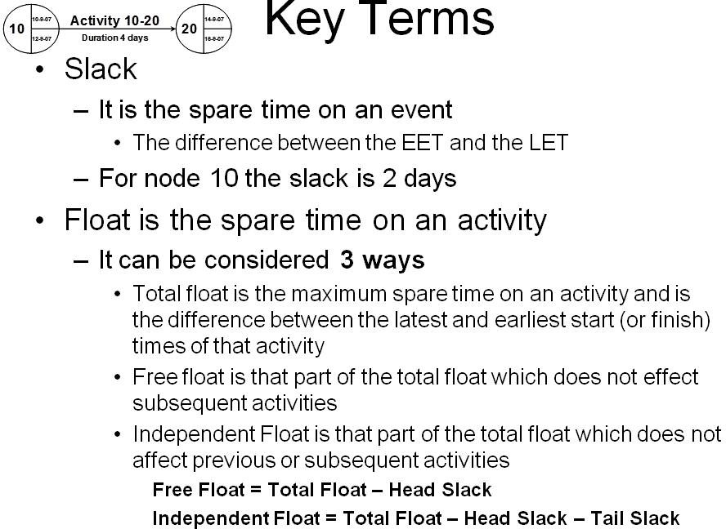
Project Management & BIM Project Scheduling Basics

Slide 28
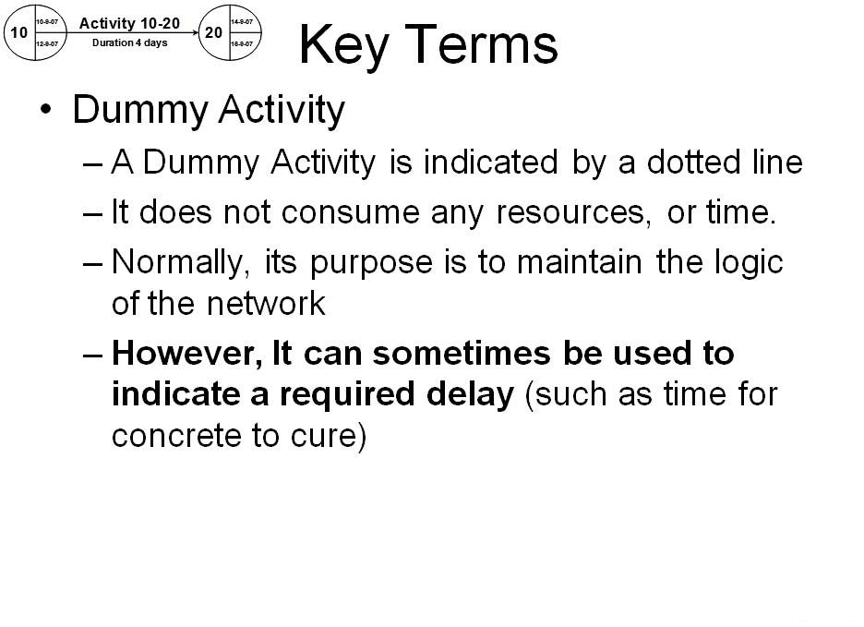
Project Management & BIM Project Scheduling Basics

Slide 29
Project Management & BIM Activity on Arrow
Basic Project Scheduling
Activity on Arrow

Slide 30
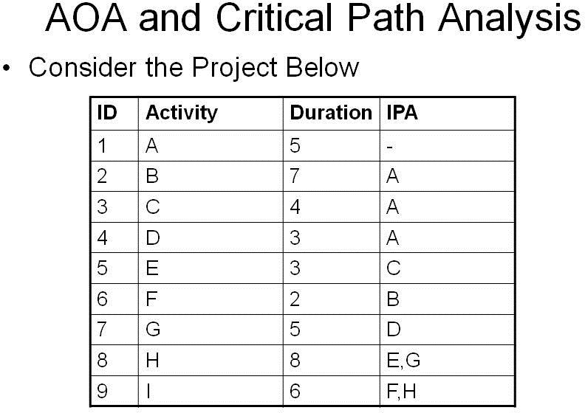
Project Management & BIM Activity on Arrow

Slide 31
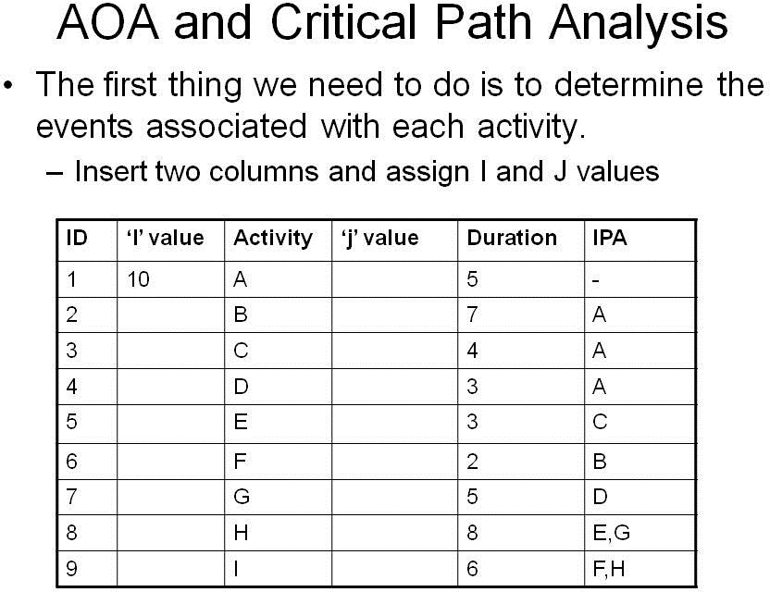
Project Management & BIM Activity on Arrow

Slide 32
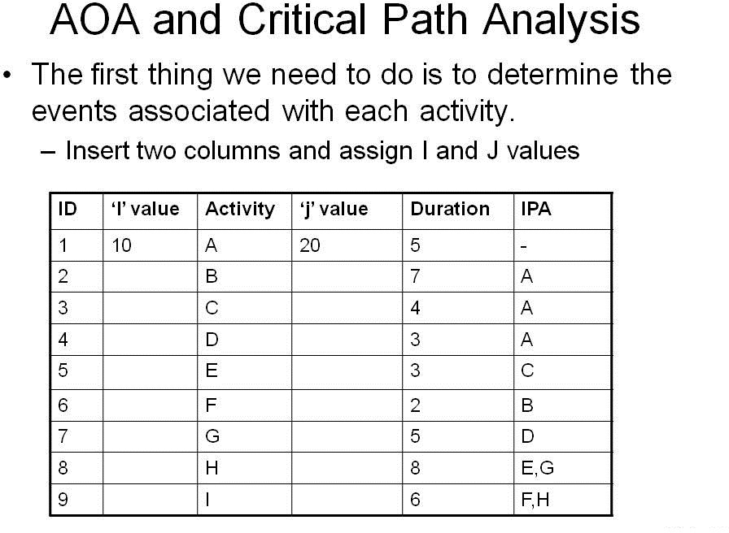
Project Management & BIM Activity on Arrow

Slide 33
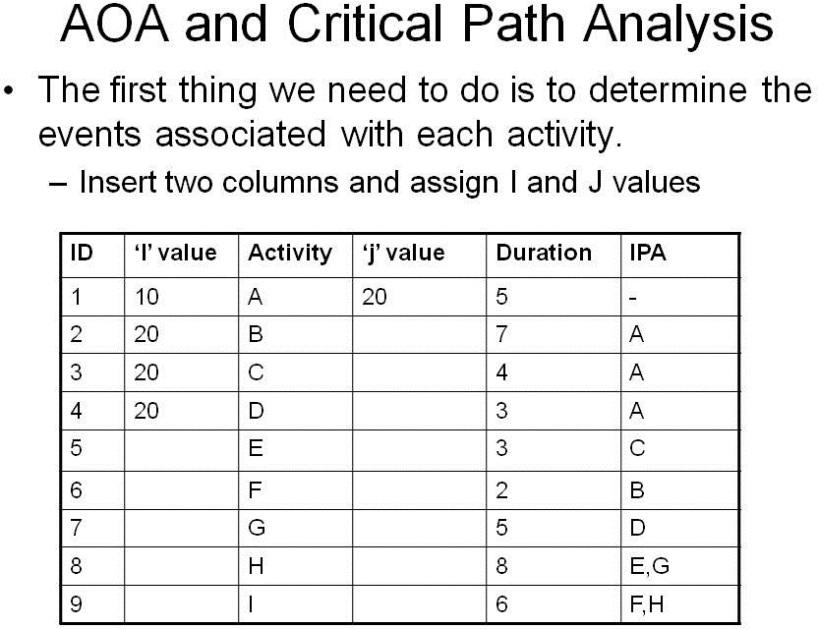
Project Management & BIM Activity on Arrow

Slide 34
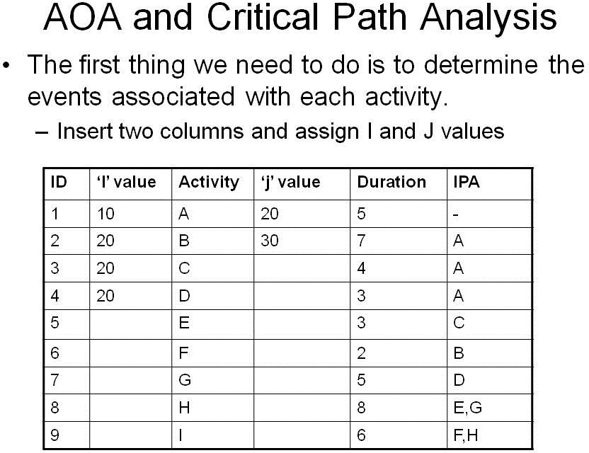
Project Management & BIM Activity on Arrow

Slide 35

Project Management & BIM Activity on Arrow

Slide 36

Project Management & BIM Activity on Arrow

Slide 37

Project Management & BIM Activity on Arrow

Slide 38

Project Management & BIM Activity on Arrow

Slide 39

Project Management & BIM Activity on Arrow

Slide 40

Project Management & BIM Activity on Arrow

Slide 41

Project Management & BIM Activity on Arrow

Slide 42
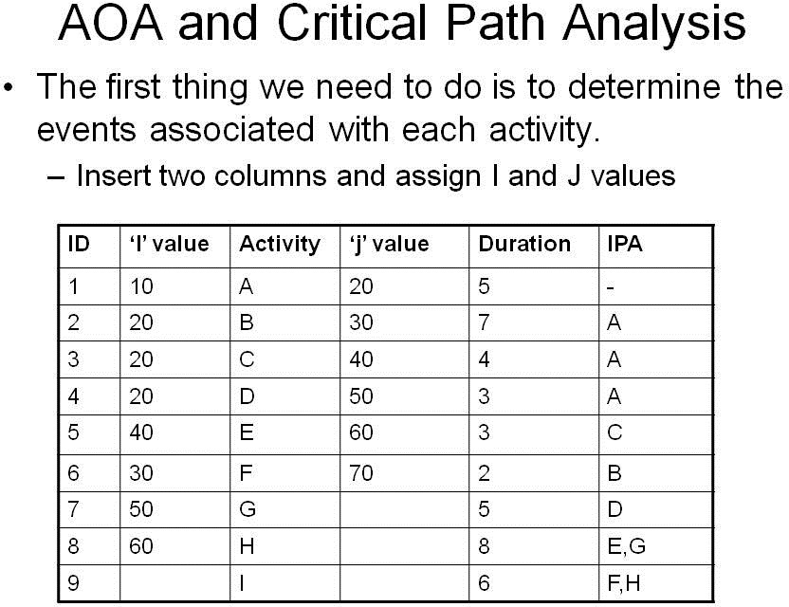
Project Management & BIM Activity on Arrow

Slide 43
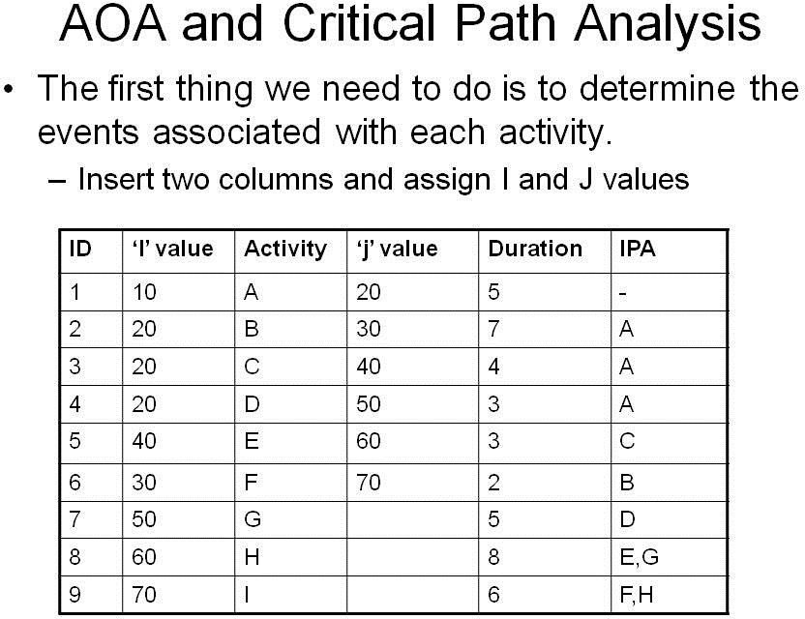
Project Management & BIM Activity on Arrow

Slide 44
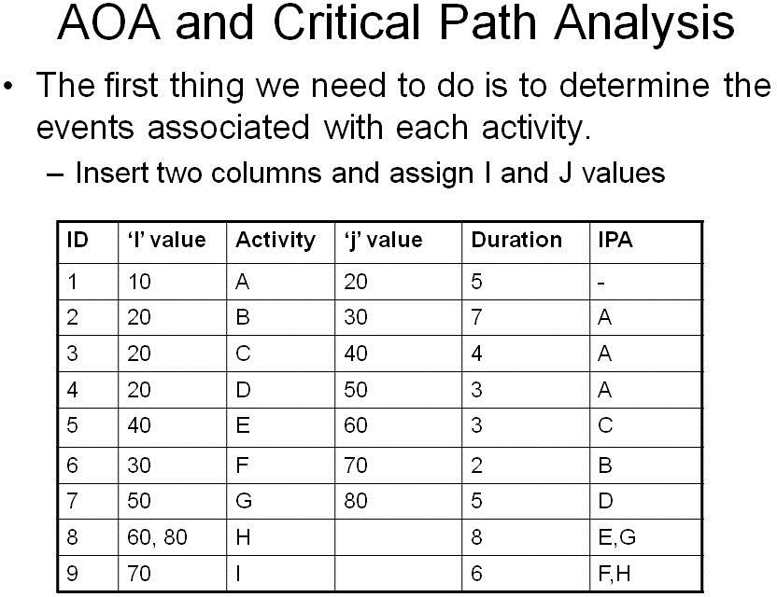
Project Management & BIM Activity on Arrow

Slide 45
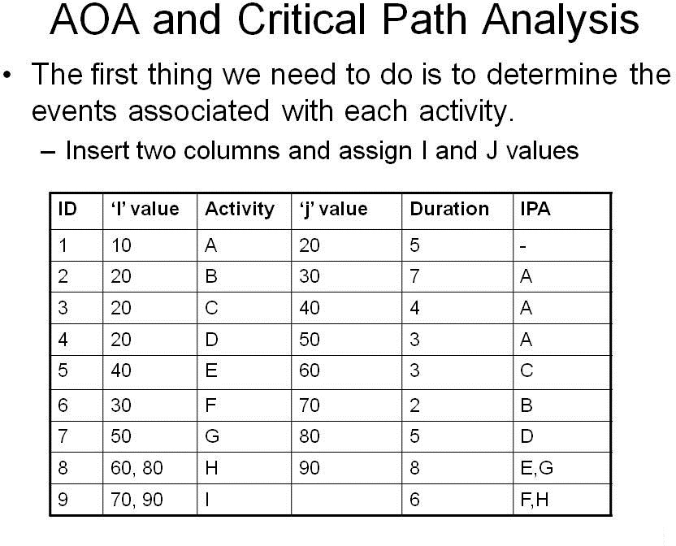
Project Management & BIM Activity on Arrow

Slide 46
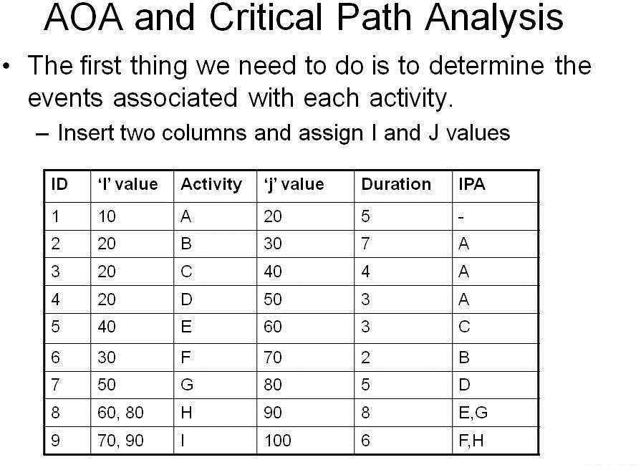
Project Management & BIM Activity on Arrow

Slide 47
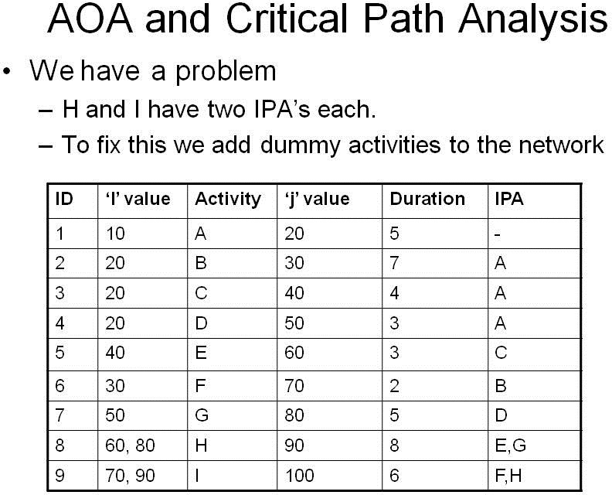
Project Management & BIM Activity on Arrow

Slide 48
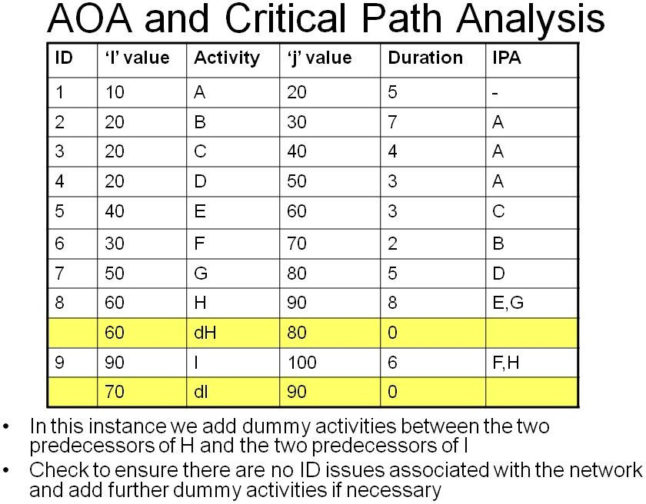
Project Management & BIM Activity on Arrow

Slide 49
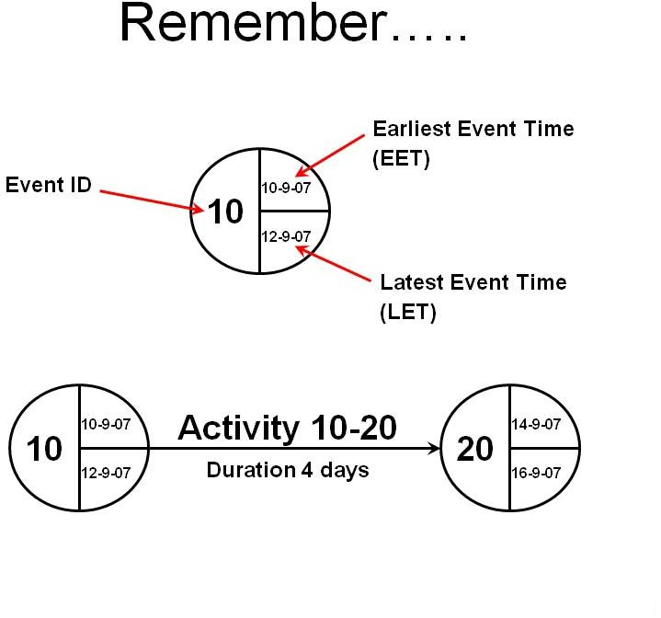
Project Management & BIM Activity on Arrow

Slide 50
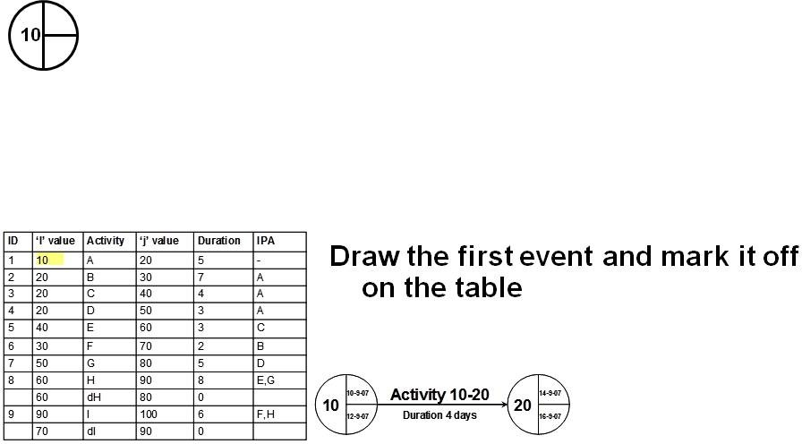
Project Management & BIM Activity on Arrow

Slide 51
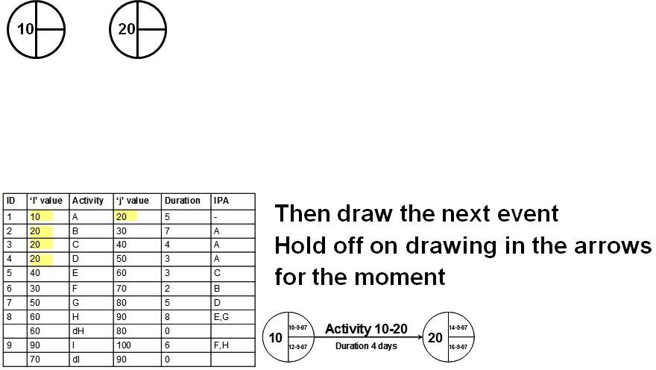
Project Management & BIM Activity on Arrow

Slide 52
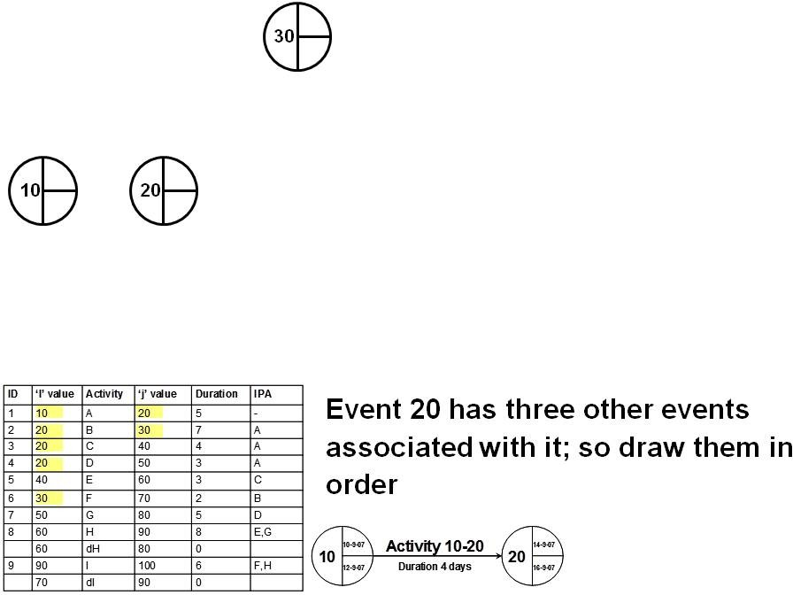
Project Management & BIM Activity on Arrow

Slide 53
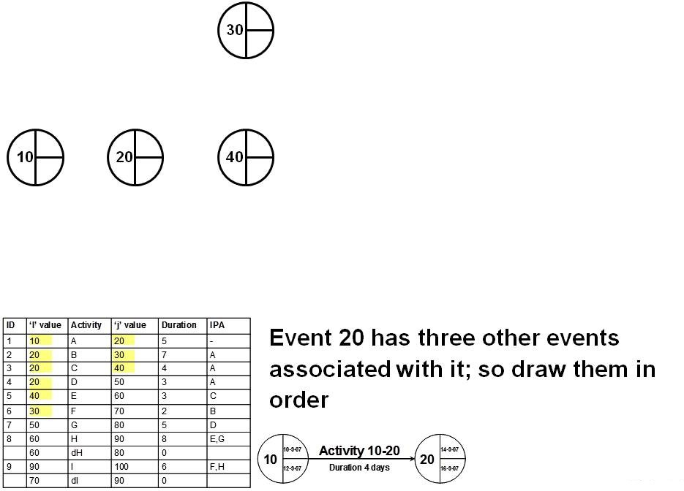
Project Management & BIM Activity on Arrow

Slide 54
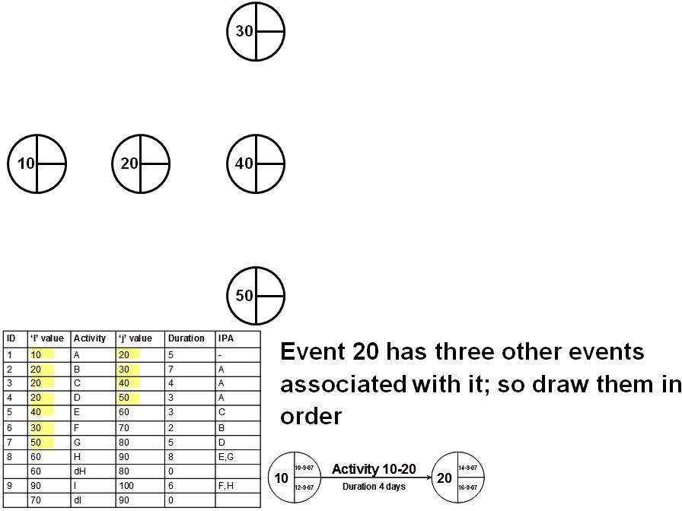
Project Management & BIM Activity on Arrow

Slide 55
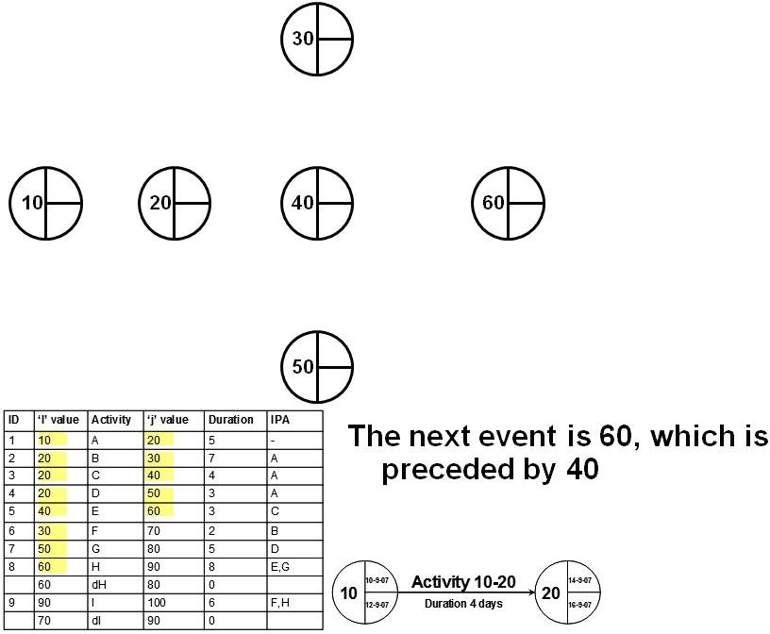
Project Management & BIM Activity on Arrow

Slide 56
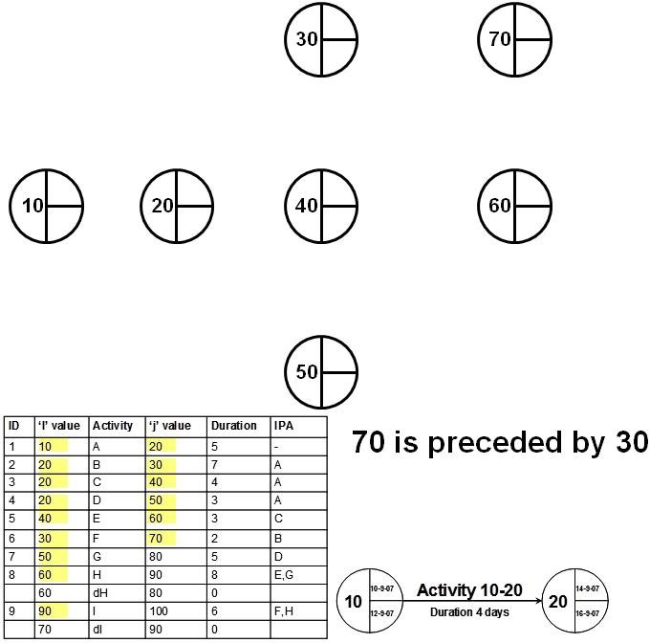
Project Management & BIM Activity on Arrow

Slide 57
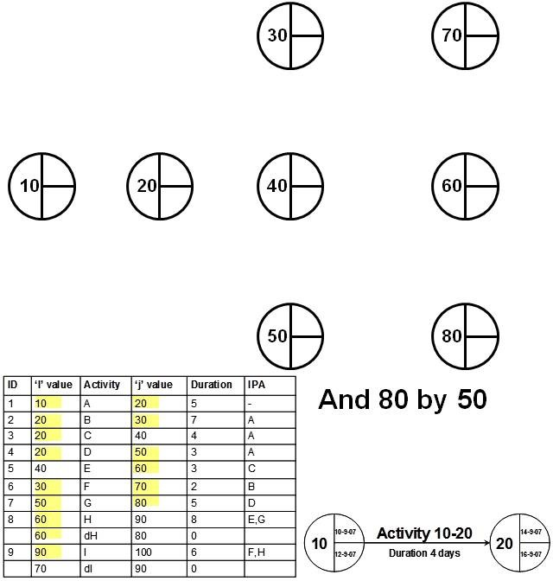
Project Management & BIM Activity on Arrow

Slide 58
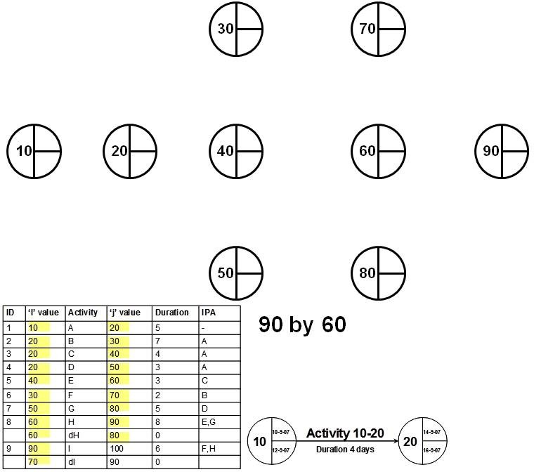
Project Management & BIM Activity on Arrow

Slide 59
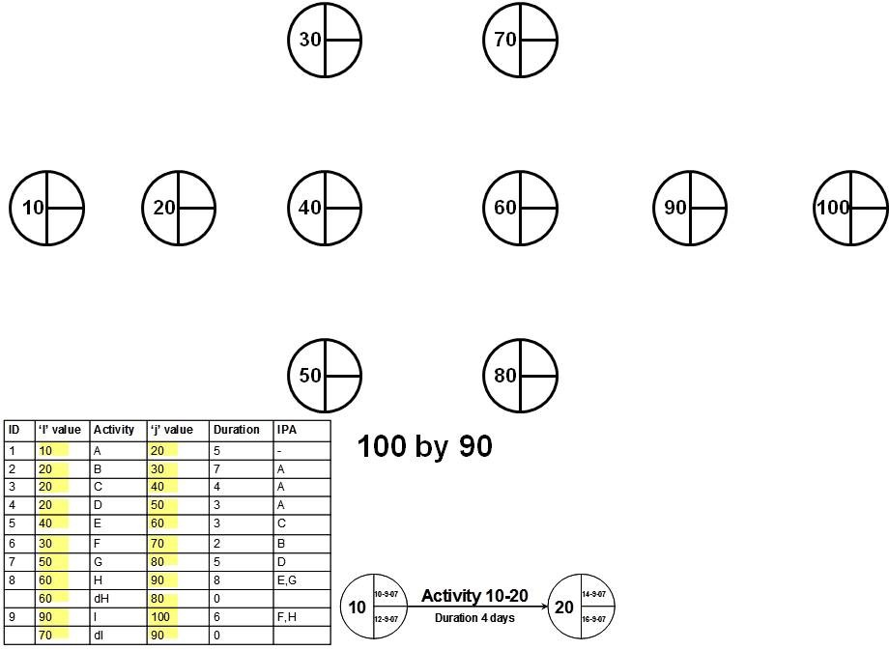
Project Management & BIM Activity on Arrow

Slide 60
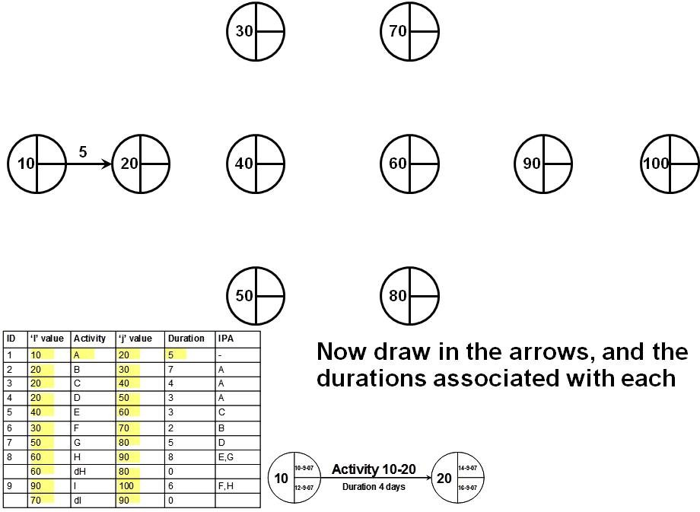
Project Management & BIM Activity on Arrow

Slide 61
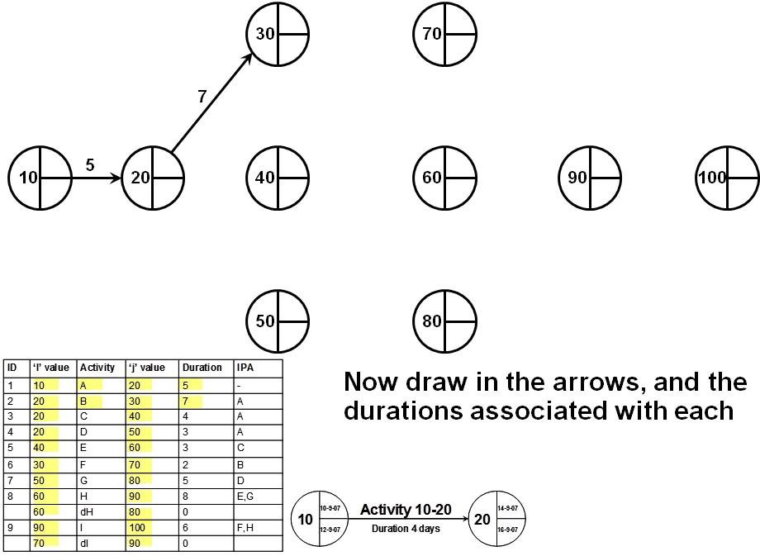
Project Management & BIM Activity on Arrow

Slide 62

Project Management & BIM Activity on Arrow

Slide 63

Project Management & BIM Activity on Arrow

Slide 64

Project Management & BIM Activity on Arrow

Slide 65

Project Management & BIM Activity on Arrow

Slide 66

Project Management & BIM Activity on Arrow

Slide 67

Project Management & BIM Activity on Arrow

Slide 68

Project Management & BIM Activity on Arrow

Slide 69

Project Management & BIM Activity on Arrow

Slide 70

Project Management & BIM Activity on Arrow

Slide 71

Project Management & BIM Activity on Arrow

Slide 72

Project Management & BIM Activity on Arrow

Slide 73

Project Management & BIM Activity on Arrow

Slide 74

Project Management & BIM Activity on Arrow

Slide 75

Project Management & BIM Activity on Arrow

Slide 76

Project Management & BIM Activity on Arrow

Slide 77

Project Management & BIM Activity on Arrow

Slide 78

Project Management & BIM Activity on Arrow

Slide 79

Project Management & BIM Activity on Arrow

Slide 80

Project Management & BIM Activity on Arrow

Slide 81

Project Management & BIM Activity on Arrow

Slide 82

Project Management & BIM Activity on Arrow

Slide 83

Project Management & BIM Activity on Arrow

Slide 84

Project Management & BIM Activity on Arrow

Slide 85

Project Management & BIM Activity on Arrow

Slide 86

Project Management & BIM Activity on Arrow

Slide 87

Project Management & BIM Activity on Arrow

Slide 88

Project Management & BIM Activity on Arrow

Slide 89

Project Management & BIM Activity on Arrow

Slide 90

Project Management & BIM Activity on Arrow

Slide 91

Project Management & BIM Activity on Arrow

Slide 92
Project Management & BIM Activity on Node
Basic Project Scheduling
Activity on Node
Precedence Diagrams

Slide 93

Project Management & BIM Activity on Node

Slide 94

Project Management & BIM Activity on Node

Slide 95

Project Management & BIM Activity on Node

Slide 96

Project Management & BIM Activity on Node

Slide 97

Project Management & BIM Activity on Node

Slide 98

Project Management & BIM Activity on Node

Slide 99

Project Management & BIM Activity on Node

Slide 100

Project Management & BIM Activity on Node

Slide 101

Project Management & BIM Activity on Node

Slide 102

Project Management & BIM Activity on Node

Slide 103

Project Management & BIM Activity on Node

Slide 104

Project Management & BIM Activity on Node

Slide 105

Project Management & BIM Activity on Node

Slide 106

Project Management & BIM Activity on Node

Slide 107

Project Management & BIM Activity on Node

Slide 108

Project Management & BIM Activity on Node

Slide 109

Project Management & BIM Activity on Node

Slide 110

Project Management & BIM Activity on Node

Slide 111

Project Management & BIM Activity on Node

Slide 112

Project Management & BIM Activity on Node

Slide 113

Project Management & BIM Activity on Node

Slide 114

Project Management & BIM Activity on Node

Slide 115

Project Management & BIM Activity on Node

Slide 116

Project Management & BIM Activity on Node

Slide 117

Project Management & BIM Activity on Node

Slide 118

Project Management & BIM Activity on Node

Slide 119

Project Management & BIM Activity on Node

Slide 120

Project Management & BIM Activity on Node

Slide 121

Project Management & BIM Activity on Node

Slide 122

Project Management & BIM Activity on Node

Slide 123

Project Management & BIM Activity on Node

Slide 124

Project Management & BIM Activity on Node

Slide 125

Project Management & BIM Activity on Node

Slide 126

Project Management & BIM Activity on Node

Slide 127

Project Management & BIM Activity on Node

Slide 128

Project Management & BIM Activity on Node

Slide 129

Project Management & BIM Activity on Node

Slide 130

Project Management & BIM Activity on Node

Slide 131

Project Management & BIM Activity on Node

Slide 132

Project Management & BIM Activity on Node

Slide 133

Project Management & BIM Activity on Node

Slide 134

Project Management & BIM Activity on Node

Slide 135

Project Management & BIM Activity on Node

Slide 136

Project Management & BIM Activity on Node

Slide 137

Project Management & BIM Activity on Node

Slide 138

Project Management & BIM Activity on Node

Slide 139

Project Management & BIM Activity on Node

Slide 140

Project Management & BIM Activity on Node

Slide 141

Project Management & BIM Activity on Node

Slide 142

Project Management & BIM Activity on Node

Slide 143

Project Management & BIM Activity on Node

Slide 144

Project Management & BIM Activity on Node

Slide 145

Project Management & BIM Activity on Node

Slide 146

Project Management & BIM Activity on Node

Slide 147

Project Management & BIM Activity on Node

Slide 148

Project Management & BIM Activity on Node

Slide 149

Project Management & BIM Activity on Node

Slide 150

Project Management & BIM Activity on Node

Slide 151

Project Management & BIM Activity on Node

Slide 152

Project Management & BIM Activity on Node

Slide 153

Project Management & BIM Activity on Node

Slide 154

Project Management & BIM Activity on Node

Slide 155

Project Management & BIM Activity on Node

Slide 156

Project Management & BIM Activity on Node

Slide 157
Project Management & BIM Activity on Node
Project Scheduling
Activity on Node
Precedence Diagrams – More Detailed

Slide 158

Project Management & BIM Activity on Node

Slide 159

Project Management & BIM Activity on Node

Slide 160

Project Management & BIM Activity on Node

Slide 161

Project Management & BIM Activity on Node

Slide 162

Project Management & BIM Activity on Node

Slide 163

Project Management & BIM Activity on Node

Slide 164

Project Management & BIM Activity on Node

Slide 165

Project Management & BIM Activity on Node

Slide 166

Project Management & BIM Activity on Node

Slide 167

Project Management & BIM Activity on Node

Slide 168

Project Management & BIM Activity on Node

Slide 169

Project Management & BIM Activity on Node

Slide 170

Project Management & BIM Activity on Node

Slide 171

Project Management & BIM Activity on Node

Slide 172

Project Management & BIM Activity on Node

Slide 173

Project Management & BIM Activity on Node

Slide 174

Project Management & BIM Activity on Node

Slide 175

Project Management & BIM Activity on Node

Slide 176

Project Management & BIM Activity on Node

Slide 177

Project Management & BIM Activity on Node

Slide 178

Project Management & BIM Activity on Node

Slide 179

Project Management & BIM Activity on Node

Slide 180

Project Management & BIM Activity on Node

Slide 181

Project Management & BIM Activity on Node

Slide 182

Project Management & BIM Activity on Node

Slide 183

Project Management & BIM Activity on Node

Slide 184

Project Management & BIM Activity on Node

Slide 185

Project Management & BIM Activity on Node

Slide 186

Project Management & BIM Activity on Node

Slide 187
Project Management & BIM Activity on Node

Slide 188

Project Management & BIM Activity on Node

Slide 189

Project Management & BIM Activity on Node

Slide 190

Project Management & BIM Activity on Node

Slide 191

Project Management & BIM Activity on Node

Slide 192

Project Management & BIM Activity on Node

Slide 193

Project Management & BIM Activity on Node

Slide 194

Project Management & BIM Activity on Node

Slide 195

Project Management & BIM Activity on Node

Slide 196

Project Management & BIM Activity on Node

Slide 197

Project Management & BIM Activity on Node

Slide 198

Project Management & BIM Activity on Node

Slide 199

Project Management & BIM Activity on Node

Slide 200

Project Management & BIM Activity on Node

Slide 201

Project Management & BIM Activity on Node

Slide 202

Project Management & BIM Activity on Node

Slide 203

Project Management & BIM Activity on Node

Slide 204

Project Management & BIM Activity on Node

Slide 205

Project Management & BIM Activity on Node

Slide 206

Project Management & BIM Activity on Node

Slide 207

Project Management & BIM Activity on Node

Slide 208

Project Management & BIM Activity on Node

Slide 209

Project Management & BIM Activity on Node

Slide 210
Project Management & BIM Line of Balance
Project Scheduling
Line of Balance

Slide 211

Project Management & BIM Line of Balance

Slide 212

Project Management & BIM Line of Balance

Slide 213

Project Management & BIM Line of Balance

Slide 214

Project Management & BIM Line of Balance

Slide 215

Project Management & BIM Line of Balance

Slide 216

Project Management & BIM Line of Balance

Slide 217

Project Management & BIM Line of Balance

Slide 218

Project Management & BIM Line of Balance

Slide 219

Project Management & BIM Line of Balance

Slide 220

Project Management & BIM Line of Balance

Slide 221

Project Management & BIM Line of Balance

Slide 222
Project Management & BIM Line of Balance

Slide 223

Project Management & BIM Line of Balance

Slide 224

Project Management & BIM Line of Balance

Slide 225

Project Management & BIM Line of Balance

Slide 226

Project Management & BIM Line of Balance

Slide 227

Project Management & BIM Line of Balance

Slide 228

Project Management & BIM Line of Balance

Slide 229

Project Management & BIM Line of Balance

Slide 230

Project Management & BIM Line of Balance

Slide 231

Project Management & BIM Line of Balance

Slide 232

Project Management & BIM Line of Balance

Slide 233

Project Management & BIM Line of Balance

Slide 234

Project Management & BIM Line of Balance

Slide 235

Project Management & BIM Line of Balance

Slide 236

Project Management & BIM Line of Balance

Slide 237

Project Management & BIM Line of Balance

Slide 238

Project Management & BIM Line of Balance

Slide 239

Project Management & BIM Line of Balance

Slide 240

Project Management & BIM Line of Balance

Slide 241

Project Management & BIM Line of Balance

Slide 242

Project Management & BIM Line of Balance

Slide 243

Project Management & BIM Line of Balance

Slide 244

Project Management & BIM Line of Balance

Slide 245

Project Management & BIM Line of Balance

Slide 246

Project Management & BIM Line of Balance

Slide 247

Project Management & BIM Line of Balance

Slide 248

Project Management & BIM Line of Balance

Slide 249

Project Management & BIM Line of Balance

Slide 250

Project Management & BIM Line of Balance

Slide 251

Project Management & BIM Line of Balance

Slide 252

Project Management & BIM Line of Balance

Slide 253

Project Management & BIM Line of Balance

Slide 254

Project Management & BIM Line of Balance

Slide 255

Project Management & BIM Line of Balance

Slide 256

Project Management & BIM Line of Balance

Slide 257

Project Management & BIM Line of Balance

Slide 258

Project Management & BIM Line of Balance

Slide 259

Project Management & BIM Line of Balance

Slide 260

Project Management & BIM Line of Balance

Slide 261

Project Management & BIM Line of Balance

Slide 262

Project Management & BIM Line of Balance

Slide 263

Project Management & BIM Line of Balance

Slide 264

Project Management & BIM Line of Balance

Slide 265
Project Management & BIM Time Chainage
Project Scheduling
Time Chainage

Slide 266

Project Management & BIM Time Chainage

Slide 267

Project Management & BIM Time Chainage

Slide 268

Project Management & BIM Time Chainage

Slide 269

Project Management & BIM Time Chainage

Slide 270

Project Management & BIM Time Chainage

Slide 271

Project Management & BIM Time Chainage

Slide 272

Project Management & BIM Time Chainage

Slide 273

Project Management & BIM Time Chainage

Slide 274

Project Management & BIM Time Chainage

Slide 275

Project Management & BIM Time Chainage

Slide 276

Project Management & BIM Time Chainage

Slide 277

Project Management & BIM Time Chainage

Slide 278

Project Management & BIM Time Chainage

Slide 279

Project Management & BIM Time Chainage

Slide 280

Project Management & BIM Time Chainage

Slide 281

Project Management & BIM Time Chainage

Slide 282

Project Management & BIM Time Chainage

Slide 283
Project Management & BIM PMBOK Processes
Project Time Management
Define Activities Sequence Activities
Estimate Activity Resources Estimate Activity Durations Develop Schedule
Control Schedule
We have already covered some of the material for Time Management, namely:
Gantt Charts, Network Diagrams, Line of Balance, Time Chainage, PERT

Slide 284

Project Management & BIM PMBOK Processes
Define Activities
Part of the Planning Process Group

Slide 285
Project Management & BIM PMBOK Processes
Define Activities
Generally, Activity definition involves identifying and documenting schedule activities at the lowest level of the WBS i.e. work packages
There is an overlap between WBS, WBS Dictionary and Activity Definition
The main difference is that the WBS decomposes the project in terms of deliverables, and ‘Activity Definition’ decomposes the project in terms of schedule activities Ideally, ‘WBS’, ‘WBS Dictionary’, and ‘Activity Definition’ should be carried out in parallel.

Slide 286
Project Management & BIM PMBOK Processes
Tools and Techniques Rolling Wave Planning
AKA Moving Window planning
Rolling Wave planning is a form of ’progressive elaboration’, whereby work to be accomplished in the near future is planned in detail at low levels of the WBS
Elements further into the future are only planned to the upper levels in the WBS
Increases the risks associated with the project
For complex projects, it is often the only way to execute Two key points to consider:
How far out you can plan in detail will vary considerably from project to project
It works best when client and upper management understand how the technique works

Slide 287

Project Management & BIM PMBOK Processes
If the client or senior managers are not aware of the effects of progressive elaboration, there can be serious effects.
Project budgets are normally set at the early stages of the project. Where PE is being used, a probability should be assigned to estimated costs to ensure funding will be available.

Slide 288
Project Management & BIM PMBOK Processes
Cost Estimate Accuracy
WBS |  | Estimate | Accuracy
Level | Description | Low Risk Projects | High Risk Projects
1 | Program | ±35% | ±75-100%
2 | Project | ±20% | ±50-60%
3 | Task | ±10% | ±20-30%
4 | Subtask | ±5% | ±10-15%
5 | Work Package | ±2% | ±5-10%
Table: Kerzner (2009), P569
This partially explains why tender prices can vary as much as 30% between highest and lowest

Slide 289
Project Management & BIM PMBOK Processes
Define Activities
Outputs
Activity List
Comprehensive list of all schedule activities
Activity Attributes
Activity identifier Predecessors - Successors Logic Relationships
Leads - Lags
Resource Requirements
Milestone List
Mandatory or otherwise

Slide 290

Project Management & BIM PMBOK Processes
Sequence Activities
Part of the Planning Process Group

Slide 291

Project Management & BIM PMBOK Processes
Sequence Activities
Activity Sequencing Involves identifying and documenting the logical relationship amongst schedule activities
The logical relationships between schedule activities must be considered when determining project schedules
Tools and techniques for this have already been covered :

Slide 292
Project Management & BIM PMBOK Processes
Tools and Techniques
Precedence Diagrams
Already covered
Dependency Determination
Mandatory or ’Hard Logic’, Inherent in the nature of the work being done
Discretionary, ’Preferred Logic’, ’Soft Logic’ e.g. Landscaping
External: Usually driven by dependencies between project activities and non-project activities such as Planning Permission, IPC Licence, etc.

Slide 293
Project Management & BIM PMBOK Processes
Tools and Techniques
Leads and Lags
Concrete set time typically creates a Lag Refer to book
Schedule Network Templates
Entire project or portions of the project
Allows transfer of information from project to project (Knowledge Management)
Lessens the likelihood of ’errors of omission’

Slide 294

Project Management & BIM PMBOK Processes
Estimate Activity Resources
Part of the Planning Process Group

Slide 295
Project Management & BIM PMBOK Processes
Estimate Activity Resources
Inputs
Refer to Book..
Resource calendars: Concerned with resource availability
People, Equipment, Materials
People: are appropriate skill sets available? Equipment: Own or Hire
Materials: Availability, Storage, lead times, etc.

Slide 296

Project Management & BIM PMBOK Processes
Tools and Techniques
Alternatives Analysis
Machine Types, Size, etc. Make or Buy?
Published Estimating Data
e.g. Spon’s Guides - Contains time and money data
Bottom Up Estimating
Most difficult and time consuming, however if done properly is highly accurate
Project Management Software
MS Project Resource Sheets, etc.

Slide 297

Project Management & BIM PMBOK Processes
Bottom-Up Estimating Example
Installation of a water meter box
Time Locate existing stop-tap Setup equipment Excavate Cut and Remake Connections Fill and Compact Concrete Collar | 5 min 15 min 10 min 10 min 10 min 10 min
Total Time | 60 min
Cost Van, Tools & equip Labour | € 200 p/h € 120 p/h
Total Cost | € 320 p/h
This example works out direct cost and time only

Slide 298

Project Management & BIM PMBOK Processes
Estimate Activity Durations
Part of the Planning Process Group

Slide 299
Project Management & BIM PMBOK Processes
Estimate Activity Durations
Activity Duration Estimating involves:
Estimating the amount of work required to complete an activity
The level and type of resources that must be applied to complete an activity
By using the above information, an estimate of the time taken to complete the task can be derived.
All data and assumptions that support the duration estimate are documented for each activity

Slide 300
Project Management & BIM PMBOK Processes
Estimate Activity Durations
Work, Time, Resource relationship
_{Time Required =} Work Required
Resources Applied
Note: this is a pseudo-mathematical relationship.
The actual mathematical relationship will depend on how the 3 elements (work, time, resource) are defined.
The mathematical relationship is better described below:
t = f (w, r)

Slide 301
Project Management & BIM PMBOK Processes
Tools & Techniques
Expert Judgment
Refer to Book
Very common, but not accurate enough; should be combined with one or more other methods to improve accuracy
Analogous Estimating
Means using the actual duration of a previous similar activity as the basis for estimating the duration of a future schedule activity
Very common method.

Slide 302
Project Management & BIM PMBOK Processes
Tools & Techniques
Parametric Estimating
Using the work, time, resource relationship
t = f (w, r)
Parametric Estimating is a process by which the duration of an activity can be quantitatively determined by multiplying the quantity of work to be performed by the productivity rate
Can be highly accurate. However, beware of inaccurate base data, or improperly used base data.

Slide 303

Project Management & BIM PMBOK Processes
SPON’s Architects & Builders

Slide 304

Project Management & BIM PMBOK Processes
SPON’s Mech & Elec

Slide 305
Project Management & BIM PMBOK Processes
Three-Point Estimates
The accuracy of a duration estimate can be improved by considering the amount of risk in the original estimate. Three types of estimate are produced:
Most Likely Optimistic Pessimistic
The average of these three estimates is taken Average Duration
t + t + t
o m p
3
t =
e
Weighted Average Duration (as per PERT)
t + 4t + t
o m p
6
t =
e

Slide 306
Project Management & BIM PMBOK Processes
Reserve Analysis
Reserve analysis means adding time to a previously determined (or estimated) activity duration to account for:
Potential Data inaccuracies (analogous, parametric etc.) Schedule risks (resource availability etc.)
Contingencies can be based on %age of estimated activities, fixed durations, etc.
Contingency reserves can be utilised, reduced or eliminated as the project progresses and more information becomes available All aspects of contingency reserves should be documented

Slide 307
Project Management & BIM PMBOK Processes
Activity Duration Estimating
Outputs
Activity Durations Estimates: quantitative assessments of the work periods (time) that will be required to complete schedule activities
2 weeks ± 2 days
85% probability of 12 days Project Document Updates
Refer to book and previous lectures

Slide 308

Project Management & BIM PMBOK Processes
Develop Schedule
Part of the Planning Process Group

Slide 309
Project Management & BIM PMBOK Processes
Develop Schedule
Schedule Development is an iterative process to determine the planned start and planned completion dates for project activities Duration Estimates and Resource Estimates may need to be revised in order to develop an accurate schedule against which project progress can be tracked
The initial Project Schedule is known as the ‘Baseline Schedule’.
Schedule Development continues throughout the course of the project.
Risk Events may occur, or may not occur Resource Availabilities may change Scope may change
Etc.

Slide 310
Project Management & BIM PMBOK Processes
Tools & Techniques
Network Analysis, CPM, Critical Chain Already covered in lectures
Refer to Book for further details Schedule Compression
Crashing Fast Tracking
What-if Scenario Analysis Resource Leveling

Slide 311
Project Management & BIM PMBOK Processes
Schedule Compression
Schedule Compression shortens the project schedule without changing the project scope.
Crashing: shortening activity durations, in order to shorten the overall project duration
Fast-Tracking: commencing phases (or activities) before their logical predecessor is completed.

Slide 312
Project Management & BIM PMBOK Processes
Crashing
Shortening Activity durations in order to shorten overall project duration.
Usually involves shortening durations on the critical path. Shortening durations on the Critical Path may change the Critical Path
Crashing normally involves increased costs
Crashing involves increasing the resources (labour and/or equipment) assigned to an activity.
Remember:
_{Time Required =} Work Required
Resources Applied
You cannot change the work; the scope must remain unchanged

Slide 313
Project Management & BIM PMBOK Processes
Crashing
Never crash a project at planning stage
At planning stage you should be looking at building in schedule contingency.
If you are crashing at planning stage then you have underestimated resources or resource availability (need to re-plan, not crash)
Better to look at:
Sequence of Activities Internal v. External Resources
Modification of Scope (requires stakeholder approval)

Slide 314
Project Management & BIM PMBOK Processes
Crashing
A correctly planned and executed project should not require crashing
Crashing a project should be looked upon as the last resort for bringing a project back on schedule
Not all activities can be crashed
It takes one woman nine months to have a baby. It cannot be done in one month by impregnating nine women.
Crashing an activity will always be subject to some form of constraint

Slide 315
Project Management & BIM PMBOK Processes
Crashing
Trade-offs
Increased Cost Increased Risk
Not just Schedule Risk; Health & Safety may be compromised, H&S should never be compromised.
Typically increased management effort is required
Crashing one project may have a detrimental effect on other projects (or operations) being undertaken by the organization

Slide 316

Project Management & BIM PMBOK Processes

Slide 317

Project Management & BIM PMBOK Processes

Slide 318

Project Management & BIM PMBOK Processes

Slide 319

Project Management & BIM PMBOK Processes

Slide 320

Project Management & BIM PMBOK Processes

Slide 321

Project Management & BIM PMBOK Processes

Slide 322
Project Management & BIM PMBOK Processes
More on Crashing
If you must crash a project, consider the following:
If you are crashing to bring a project back on schedule: Don’t crash too early; If you need to crash early activities then chances are that the schedule is wrong in the first
place, or there has been a delay. Better to get an EOT.
You can’t crash what you have already done, or what is already in progress. Crashing tasks while in progress tends to lead to confusion. Better to look ahead and plan the crashing of an activity.
Crashing a construction project can put too many people in
the same physical location, thus impeding progress and reducing productivity

Slide 323
Project Management & BIM PMBOK Processes
More on Crashing
If you must crash a project, consider the following: Financial Aspects
If LD clause exists, then compare crash costs against LD’s. It may be cheaper to pay the LD’s
Make sure you understand the effects of crashing on the financial aspects of the project. i.e. if 25% is added to the project cost, will it still be financially viable?

